Slide 1
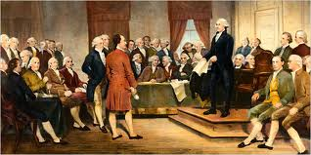
What were some of the key influences on the colonists’ views of government?
Lesson Goal: Trace the impact that the Magna Carta, English Bill of Rights, Mayflower Compact, and Thomas Paine’s Common Sense had on colonists’ views of government.
_____I can identify the important ideas contained in the Magna Carta, English Bill of Rights, Mayflower Compact, and Common Sense.
_____I can evaluate the impact that the Magna Carta, English Bill of Rights, Mayflower Compact, and Common Sense had on the purposes of government.

Slide 2
Colonial Influences: Freedom Documents
Our Founding Fathers did not invent the American system of government out of thin air. They, like the other colonists, were influenced by many different ideas and traditions. The biggest influence came from their British heritage...
The Founders didn’t have the Internet, so they got their ideas from books and other printed materials. What would have been on the minds of American colonists on the verge of a revolution? Let’s take a peek at what might have been on the shelf of a private colonial library …

Slide 3
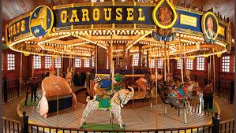
Colonial Influences: Freedom Documents
Your team will investigate five different documents that influenced the ideas that colonists had about government.
We will do a carousel document walk and research with computer and print resources.
In order to identify the ideas and evaluate the impact of these documents, please create a foldable or graphic organizer (your choice!) that includes the following:
Title: Colonial Influences: Freedom Documents
Labels for all 5 Documents (The Magna Carta, The Mayflower Compact, English Bill of Rights, Cato’s Letters, and Common Sense)
An identification of the main purpose of each document.
An explanation of the big ideas of each document.
Notes that are organized, detailed, and specific.
Summary Statement that includes an evaluation of the impact of documents on the colonists’ view of government.

Slide 4
In order to identify the ideas and evaluate the impact of these documents, please create a foldable or graphic organizer (your choice!) that includes the following:
Labels for all 5 Documents (The Magna Carta, The Mayflower Compact, English Bill of Rights, Cato’s Letters, and Common Sense)
An identification of the main purpose of each document.
An explanation of the “big ideas” of each document.
Notes that are organized, detailed, and specific.
Summary Statement that includes an evaluation of the impact of documents on the colonists’ view of government.

Slide 7
Magna Carta “The Great Charter of Freedoms”
Main Purpose: The Magna Carta’s main purpose was to limit the power of the king and protect certain rights for the nobles.
Big Idea: Limited Government
The Magna Carta limited the king’s power and provided the people with rights and due process.
Due Process: The idea that people have the right to fair and reasonable laws, and that government leaders and officials have to follow rules when enforcing laws and treat all people in the same way.

Slide 8
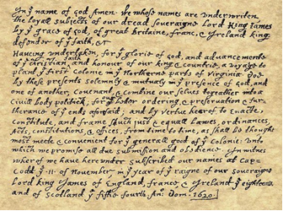
The Mayflower Compact
Main Purpose: The Mayflower Compact was created to give the Puritans a government. A compact is an official agreement made by two or more parties.
Big Idea: Self Government
Through the Mayflower Compact, the Puritans agreed to laws that will be followed by everyone and make sure that the new government will serve the common good.

Slide 9
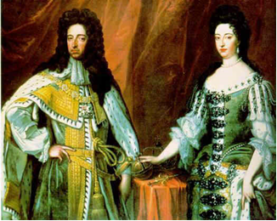
English Bill of Rights
Main Purpose: The English Bill of Rights expanded the rights of the Parliament and the people and limited the rights of the king.
Big Idea: Rights
The English Bill of Rights created free elections, the right to bear arms, petition the government and a fair trial. It also ended excessive bail and cruel and unusual punishment.

Slide 10
Cato’s Letters
Main Purpose: Cato’s Letters were newspaper editorials that focused on freedom of expression.
Big Idea: Rights
Cato’s Letters supported the right to freedom of expression and speech.

Slide 11
Common Sense
Main Purpose: Common Sense communicated the ideas for independence and made it easy to understand for everyday colonists.
Big Idea: Self-Government, Rights
Common Sense supported the idea of the colonies being independent from England in order to self govern and protect their rights.
Placed the blame for the British colonists on King George III, Challenged the authority of the British government and the royal monarchy
Published anonymously, the document advocated that the colonists declare their independence from the British crown

Slide 12
Evaluating the Impact on Government
Using what you have learned about the big ideas from each document, determine how these influences appear in the U.S. Constitution.
Read each passage
Mark the text that helps you identify the main idea.
Write the main idea in your own words.
Then, determine which of the following concepts influenced the passage and the evidence from the text that supports your answer.

Slide 13
Checking for Understanding:
Write a well-crafted informative response using one of the following prompts:
Prompt 1: Explain how the big ideas that emerged from the historical documents you read about in this lesson have been incorporated into the U.S. Constitution.
Prompt 2: Explain how the Magna Carta, English Bill of Rights, Mayflower Compact, and Common Sense have impacted the purposes of government.

Slide 14
Political Cartoon Analysis:

